Slide 1
Angular vs React

Slide 2
React vs Angular
When it is time to render too many records e.g. more than 1000 rows using Angular JS, it always raises the question regarding its performance.
Due to too many internal $watches and $digest cycle associated with each $scope value it always cost to performance of page.
The big rescue from it is ReactJS .
There is good post here by thierry.nicola where you can see that to render the 1500 rows using angularjs takes around 1.35 seconds while same for reactJS takes only around 310ms

Slide 3
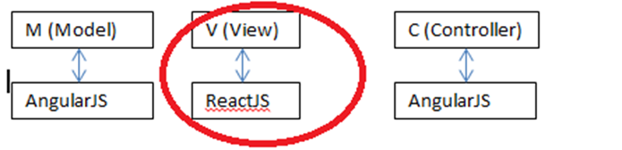
React vs Angular
React component means to build reusable functionality .
Angular js Directive ➔ React component in React js.

Slide 4
React vs Angular
Props: whatever the part of data is not going to update in component ,it will be used like read only then declare it in props.
Get id,image url,name from JSON as it is read only use props.
Note: To access props always use this.props.propName

Slide 5
React vs Angular
State: whatever the part of data is going to update in component means it will be mutable for that respective component then it will fall under state.
Note: To access state always use this.state.stateName.

Slide 6
React vs Angular
Update the string array of selectedItems which is nothing but a state of current component. As this is mutable object in component it is state.
getInitialState : It is used to provide the initial value to state or to initialize the state when component loads.
initialized the selectedItems with empty array.
getDefaultProps: provide default values for receiving props if those are failed to supply from outside.

Slide 7
React vs Angular
selectItems:This is the custom function declared for this component .Update array(state) selectedItems in this method.Send props to its child component and from child call it to modify its state.
this.setState({ :It is used to update state of component and rerenders the respective component with updated state to reflect the modified state. Call this method in selectItems function to render component to reflect its updated state.
render: It is used to render HTML mark up with your component in browser.

Slide 8
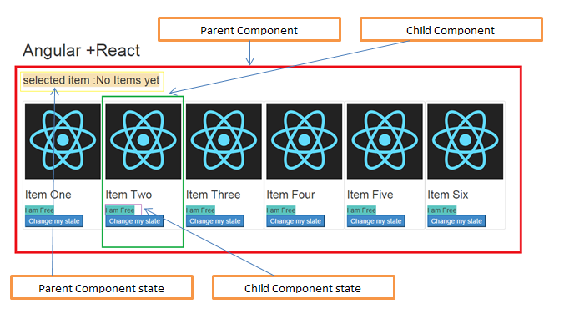




React
Each image and its associated functionality will form a child component in react and List of these child components will be a parent component of React.
I am available
I am available
I am available
I am available
Book Now
Book Now
Book Now
Book Now

Slide 9
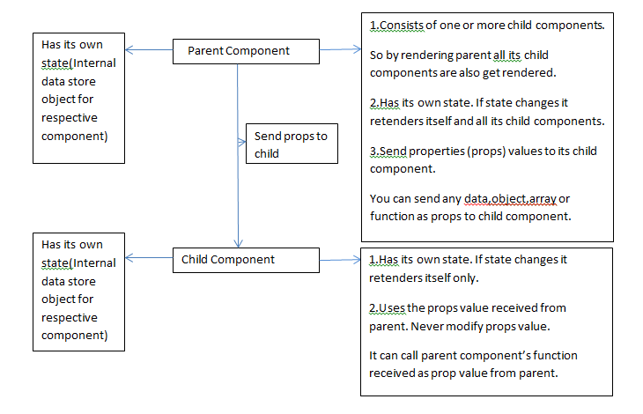
React vs Angular

Slide 10
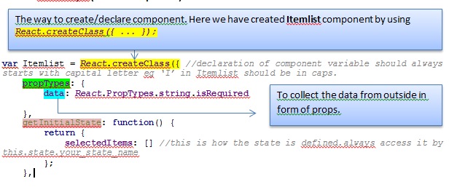
React vs Angular

Slide 11
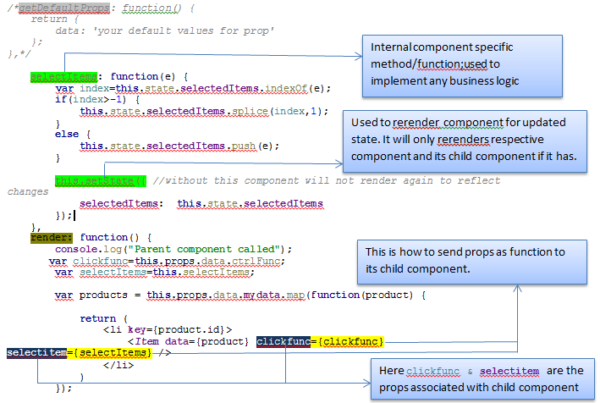
React vs Angular

Slide 12
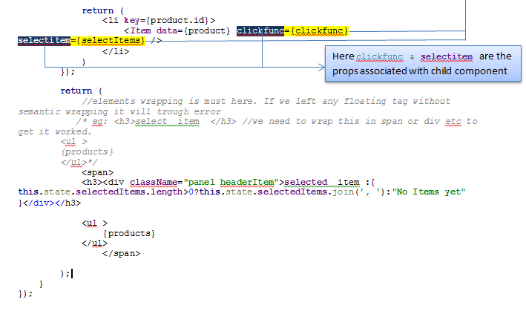
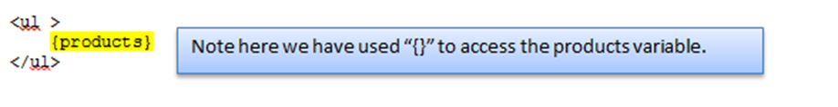
React vs Angular

Slide 13
React vs Angular
propTypes : To put the constraint on type of receiving props in component from outside.
Some examples for propsType declaration:
React.PropTypes.array,
React.PropTypes.bool,
React.PropTypes.func,
React.PropTypes.number,
React.PropTypes.object,
React.PropTypes.string,
React.PropTypes.func.isRequired

Slide 14
React vs Angular
Props: whatever the part of data is not going to update in component ,it will be used like read only then declare it in props.
Note: To access props always use this.props.propName.

Slide 15
React vs Angular
State: whatever the part of data is going to update in component means it will be mutable for that respective component then it will fall under state.
Note: To access state always use this.state.stateName.
We are updating the string array of selectedItems which is nothing but a state of current component.
As this is mutable object in component we have kept it as state.
getInitialState : It is used to provide the initial value to state or to initialize the state when component loads.

Slide 16
React vs Angular
Component_Name: react component using React.createClass method.
document.body:where to render it. Place any html tag instead of body.
e.g. document.getElementById('Div_ID').
In render function we iterated through received props (data )which is list of objects and passed it to child component Item and placed these child component one by one in <li> elements .

Slide 17
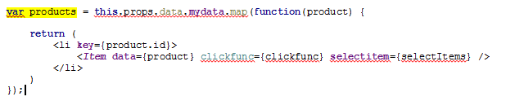

React vs Angular
BMW

Slide 18
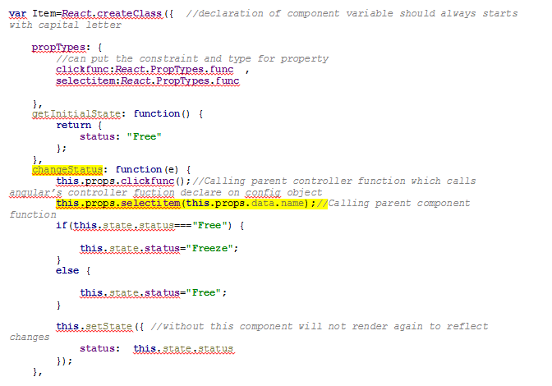
React vs Angular
Item.jsx (Child Component)->
Available
“Available”
“Booked”
“Available”

Slide 19
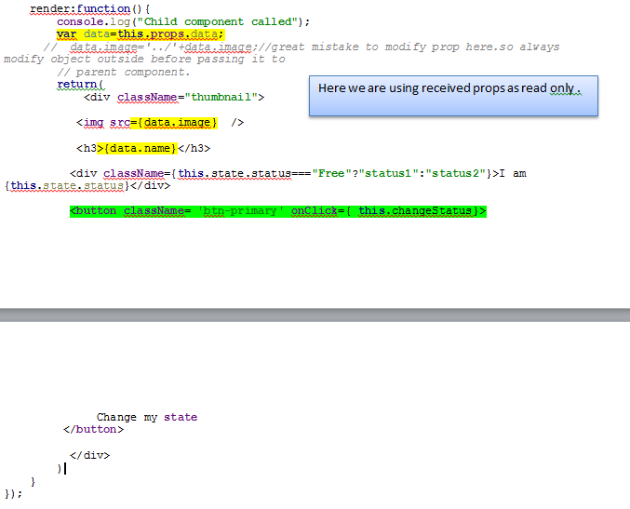
React vs Angular

